Slide 1
Cellular Networks
Outlines
Cellular Networks
Principles of Cellular Networks
First Generation (1G) Cellular and Paging Networks
Second Generation (2G) Cellular Networks
The 2.5G Cellular Networks
Third Generation (3G) Cellular Networks
Fourth Generation (4G) Cellular Networks
Overview of Fifth Generation (5G) Cellular Networks

Slide 2
Introduction to Cellular Networks
Cellular networks are wireless WANs that establish a connection between mobile users
They are comprised of many “cells” that typically cover 2 to 20 miles in area
The users communicate within a cell through wireless communications
A Base Transceiver Station (BTS), also known as a Base Station (BS), is accessed by the mobile units in each cell by using wireless communications
One BTS is assigned to each cell. Regular cable communication channels can be used to connect the BTSs to the Mobile Switching Center (MSC), also known as Mobile Telecommunications Service Center (MTSC )
The MSC is the heart of cellular networks – it determines the destination of the call received from a BTS and routes it to a proper site. It manage connections between BS and external NW.

Slide 3
Introduction to Cellular Networks
Keep in mind that the communications are wireless within a cell only
The MTSC uses two databases called Home Location Register (HLR) and Visitor location Register (VLR) to locate the mobile users
Many initial cellular network was analog because mobile communications were primarily targeted for voice users.
Cellular networks are wireless communication systems that enable devices to connect to internet and communicate with each other.
Cellular network divide geographical area into cells. Cells are served by BS.
Adjacent cells use different frequencies to avoid interference.

Slide 4
Introduction to Cellular Networks
How Cellular Phones Work?
Each cell in a cellular network is assigned a band of frequencies
In general, 10 to 50 frequencies are assigned per cell
The allocated frequencies are divided into two types of channels:
Control Channels: to setup and Maintain Calls
Traffic Channels: to carry voice and data traffic
The user of a phone goes through the following steps:
User Initiation
The user turns on the phone and scans for the strongest control signals from the various BTSs.
It detects and selects the BTS with the strongest control signal as its “home cell.” mostly, a user is assigned to the closest BTS.
The selected BTS informs the MSC about location of the user. The MSC then “registers” the user in a directory to indicate its location.

Slide 5
Introduction to Cellular Networks
How Cellular Phones Work?
Cellular to Cellular Call
The cellular user places a call; the BTS finds a free traffic channel and then routes the call to the MSC for call-setup.
The MSC finds and pages the called user by using the location services
The called user’s BTS receives the page and uses its setup control channel to be scanned by the mobile units.
The called mobile unit detects its number when it scans the setup channel and responds to its BTS to accept the call.
The BTS now informs the MSC of the call acceptance. The MSC determines that a free traffic channel is available on both sides and enables the call. If free traffic channels are not available, the user gets a busy signal

Slide 6
Introduction to Cellular Networks
How Cellular Phones Work?
Cellular to PSTN Call
The cellular user places a call; the BTS finds a free traffic channel and then routes the call to the Mobile Telecommunication Switching Office (MTSO) for call-setup.
The MTSO finds that the called user is not part of the cellular network (by looking into its directories – HLR and VLR).
The MTSO directs the call to the PSTN, used for regular telephone calls.
The called phone responds to the telephone switch to accept the call
The telephone switch now informs the MSC of the call acceptance. The MSC determines that a free traffic channel is available on the cellular side and enables the call. If a free traffic channel is not available, the user gets a busy signal

Slide 7
Introduction to Cellular Networks
How Cellular Phones Work?
PSTN to Cellular Call
The PSTN user places a call; the PSTN determines that the called number is not part of the PSTN and routes the call to an appropriate MSC for call-setup. This implies that PSTN and cellular network operators have to know about each other and route calls between them.
The MSC finds and pages the called user by using the location services
The called user’s BTS receives the page and uses its setup control channel to be scanned by the mobile units.
The called mobile unit detects its number when it scans the setup channel and responds to its BTS to accept the call.
The BTS now informs the MSC of the call acceptance. The MSC determines that a free traffic channel is available on both sides and enables the call. If free traffic channels are not available, the user gets a busy signal

Slide 8
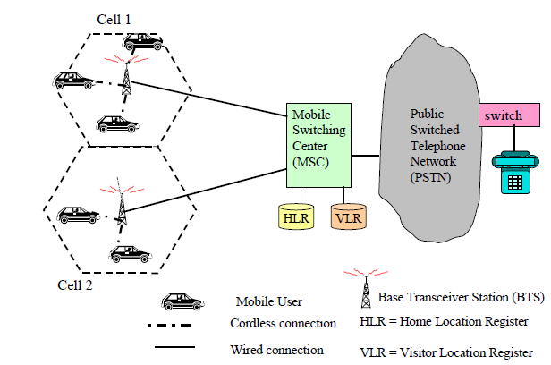
Introduction to Cellular Networks
How Cellular Phones Work?
Fig. A Cellular Network

Slide 9
Introduction to Cellular Networks
How Cellular Phones Work?
Handoff
If one of the mobile units moves from one cell to another during the call, then handoff processing takes place.
The mobile unit detects and selects the BTS with the strongest control signal as its “home cell.”
The selected BTS informs the MSC about location of the user. The MSC then “registers” the user in a directory to indicate its location.
The user is assigned a new channel in the new cell and now the calls are routed to the new cell.
All this processing takes place without any interruption.

Slide 10
Introduction to Cellular Networks
How Cellular Phones Work?
Call Termination
The two users communicate by using the traffic channels.
When the user hangs up, the traffic and control channels are freed.
Special Situations
During the aforementioned procedure, the following situations can occur:
Calls can be blocked if no free traffic channels are available. As a result, the user is given a busy signal.
Calls can be dropped if the quality of signals is too low or the noise is too high on the traffic channels for the BTS to keep a conversation going.
Calls can be routed from the PSTN to the cellular network and vice versa

Slide 11
Introduction to Cellular Networks
Highlights for Cellular Networks
Distance covered in a cell ranges from 5 miles to 20 miles
Newer systems have smaller cell sizes
Voice is the predominant application in cellular networks
The cellular networks operate in licensed frequency bands roughly between 700 MHz and 900MHz
location of a sender/receiver is unknown prior to the start of communication and can change during the conversation
Due to this, handoffs between cells must be handled very efficiently
Technics for location: Cell-id based, AOA, AGPS, TOA
Discussed in chapter three

Slide 12
Introduction to Cellular Networks
Cell Design and frequency utilization
Depending on the population density and the strength of the signal:
Most cells are between 2 to 20 miles in radius
Some cells are smaller
Each cell is served by a base transceiver station (BTS), commonly known as a base station(BS):
Consist transmitter, receiver, and control unit
Base station (BS) antennas are placed in high places such as churches and high rise buildings
Frequency reuse is referred to as the same frequency is reused after a certain distance in cellular wireless system.
generally, a limited frequency band is divided into many groups, each containing a few carriers, which are in turn assigned to adjacent cells

Slide 13
Introduction to Cellular Networks
Frequency Reuse
The concept of frequency reuse is based on assigning to each cell a group of radio channels used within a small geographic area
Cells are assigned a group of channels that is completely different from neighbouring cells
The coverage area of cells is called the footprint and is limited by a boundary so that the same group of channels can be used in cells that are far enough apart
Cells with the same number have the same set of frequencies

Slide 14
Introduction to Cellular Networks
Frequency Reuse using 7 frequencies allocations
f2
f7
f3
f2
f1
f7
f3
f6
f4
f1
f2
f5
f6
f4
f7
f3
f2
f5
f1
f7
f3
f2
f6
f4
f1
f7
f3
f5
f6
f4
f1
f5
f6
f4
f5
Each cell is generally 4 to 8 miles in diameter with a lower limit around 2 miles.

Slide 15
Introduction to Cellular Networks

Slide 16
Introduction to Cellular Networks
Problem with Smaller Clustersize
Interfering cells are closer by when clustersize is smaller.

Slide 17
Introduction to Cellular Networks

Slide 18
Introduction to Cellular Networks

Slide 19
First Generation (1G) Cellular Networks
Were introduced in 1980s
This started with the Advanced Mobile Phone Service (AMPS) that was invented at Bell Labs and first installed in 1982
AMPS has also been used in England and Japan
The key idea of 1G is that the geographical area is divided into cells (typically 10-25km), each served by a “base station”
Cells are small so that frequency reuse can be exploited in nearby (but not adjacent) cells
This allows many more users to be supported in a given area
smaller cells also require less powerful and cheaper, smaller devices to transmit and receive information
They are based primarily on analog communications
Analog cellular phones are insecure. Anyone with an all-band radio receiver can listen in to the conversation

Slide 20
First Generation (1G) Cellular Networks
Bad voice quality
Poor battery, cellphones
Big cellphones
Technology: Analog cellular
Better than nothing, at least its wireless and mobile
Bandwidth: 2Kbps

Slide 21
Paging Networks
One of the oldest wireless technology
They support one-way and two way alphanumeric messages between callers and pagers (“beepers”)
The callers typically call beeper company and leave a phone number and possibly a short message
Characteristics of Paging Networks
They were among the first wireless networks used for sending numeric and alphanumeric messages to external devices carried by mobile workers
The paging network provider (paging operator) such as Skytel, runs a paging control center which receives paging requests from regular phones, cellular phones, or other pagers and routes them to their destination pagers
The paging BTSs (Base Transceiver Stations) are connected to the paging control center through leased lines or wireless links such as satellites or wireless local loops

Slide 22
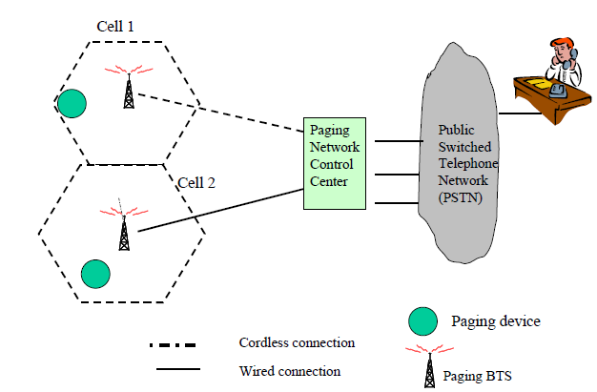
Paging Networks
Characteristics of Paging Networks
The paging networks come in two flavors: one-way paging networks and two-way paging networks.
The two-way paging networks allow pre-defined messages to be sent back by the receiver of the message
Fig. Conceptual View of a Paging Network

Slide 23
Paging Networks
Characteristics of Paging Networks
Communications protocols supported include FLEX and ReFLEX developed by Motorola for two-way paging
Security is low and has not been considered a high priority
The advantages of paging networks are:
Very inexpensive
Easy to operate for sender (from any telephone) and receiver
Many options for users (numeric, alphanumeric, two-way, message storage)
Wide coverage at local, regional , national, and international levels
Good building penetration
The limitations of paging networks are:
Slow data transfer rate (1200 bps)
No acknowledgment (two-way paging costs extra)
Some of the available paging networks are overloaded, causing delays

Slide 24
Second Generation (2G) Cellular Networks
Were introduced in the late 1980s
They are based on digital transmission
Its data speed was upto 64kbps
These are unable to handle complex data such as video
The primary differences between first and second generation cellular networks are:
Digital traffic channels –2nd generation systems are digital.
Encryption – all 2nd Generation provide encryption to prevent eavesdropping.
Error detection and correction –digital traffic allows for detection and correction, giving clear voice reception.
Channel access – 2nd generation systems allow channels to be dynamically shared by a number of users

Slide 25
Second Generation (2G) Cellular Networks
GSM stands for Global System for Mobile Communication.
GSM is an open and digital cellular technology used for mobile communication.
It uses 4 different frequency bands of 850 MHz, 900 MHz, 1800 MHz and 1900 MHz .
It uses the combination of FDMA and TDMA.
GSM uses a circuit-switched method to send the data packets
Features of GSM are :
Supports international roaming
Clear voice clarity
Ability to support multiple handheld devices.
Spectral / frequency efficiency
Low powered handheld devices.
Ease of accessing network
Low service cost.

Slide 26
The 2.5G Cellular Networks
They have been developed as a transition path to 3G
Sometimes called 2G cellular technology combined with GPRS
GPRS and EDGE are an example
Features
Phone calls
Sending/receiving email messages
Web browsing
Speed 64-144kbps
Camera phones
Take a time of 6-9 min. to download a 3 mints. mp3 music

Slide 27
The 2.5G Cellular Networks
GPRS (General Packet Radio Service )
enable moderately high-speed data transfers using packet-based technologies
GSM systems do not provide easy access and performance when multiple users access the resources concurrently and this has made GPRS systems in action to provide packet-switched services with end-to-end support
Enhanced security services are included in GPRS to ensure authentication and confidentiality and add a cipher algorithm during packet transmission.

Slide 28
The 2.5G Cellular Networks
EDGE
The phase after GPRS is called Enhanced Data Rates for GSM Evolution (EDGE)
It provides a higher rate of data transmission than normal GSM generation
It uses a backward-compatible extension of GSM of digital mobile technology
What does EDGE would mean to subscribers
Streaming applications
Very high speed downloads
Corporate intranet connections
Quicker MMS
Video phone
Vertical corporate applications - Video conference, Remote presentations

Slide 29
Third Generation (3G) Cellular Networks
Introduced in the year 2000s
Data transmission speed 144kbps-2Mbps
Typically called smart phones and features increased its bandwidth and data transfer rate to accommodate web based applications and audio and video files
Features
Providing faster communication
Send/receive large email messages
High speed/more security
video conferencing/3D gaming
TV streaming/Mobile TV/phone calls
Large capacities and broadband capabilities
11 sec-1.5 min time to download a 3 min Mp3 song

Slide 30
Third Generation (3G) Cellular Networks
UMTS stands for Universal Mobile Telecommunications Service is the best example of 3G
2G systems are based on older circuit switching systems whereas 3G systems are based on packet switching i.e. they are connectionless
Drawbacks of 3G cellular networks
Expensive fee for 3G license services
It was challenge to build the infrastructure for 3G
High bandwidth requirement
Expensive 3G phones
Large cell phones

Slide 31
Third Generation (3G) Cellular Networks
3G can provide speed up to 2mbps in business environment
802.11 can provide 11 to 54Mbps i.e superior than 3G

Slide 32
Fourth Generation (4G) Cellular Networks
Speed 100Mbps-1Gbps
High QoS and high security
Provide any kind of service at anytime as per user requirements, anywhere
Generally 4G can be described in one word MAGIC
M
Mobile multimedia
A
Anytime anywhere
G
Global mobility support
I
C
Integrated wireless solution
Customized personal services

Slide 33
Fourth Generation (4G) Cellular Networks
4G does not support circuit-switched networks but it is an IP-based network system
4G networks are the pillars as it integrates several radio access networks with fixed internet networks
Features
More security
High speed
High capacity
Low cost per bit
Table: Data rate
For High Mobility | For Low Mobility
100 Mbps | 1 Gbps

Slide 34
Fifth Generation (5G) Cellular Networks
5G is designed to have significantly greater bandwidth than 4G, with markedly faster download and upload speeds
5G cellular network support up to 10 Gbps data rate.
To place into context, the unit prefix giga describes a factor of one billion, so 10 Gbps describes 10,000,000,000 binary digits transmitted every second
5G technology promises to dramatically improve the network latency
The feature of 5G CN is support massive IOT like smart cities, high speed data sharing and angular reality and virtual reality.
5G reliable latency will be as low as 10–12 milli second and called ultra low latency.
It uses NR (new radi0) technology.

Slide 35
Fifth Generation (5G) Cellular Networks
There are 3 main areas of application for the enhanced capabilities seen with 5G
Enhanced mobile broadband (eMBB): improved connections and faster mobile services
Ultra reliable low latency communications (URLLC): services for latency-sensitive device connection such as factory automation and remote surgery by providing instantaneous and uninterrupted connectivity with a latency of as low as 1msec
Massive machine type communications (mMTC): allows for large numbers of devices to be connected to the internet and to each other, to facilitate communication between themselves, creating the Internet of Things (IoT)

Slide 36
Cellular Networks

